Slide 1
Topic Presentation Aortic Aneurysms

Slide 2
Anatomy and Physiology of Aorta
Aortic Aneurysms – Thoracic and Abdominal
Etiology & Pathogenesis
Clinical Manifestations
Diagnosis
Natural History
Management
Surgical repair
Endovascular repair
Medical management

Slide 3
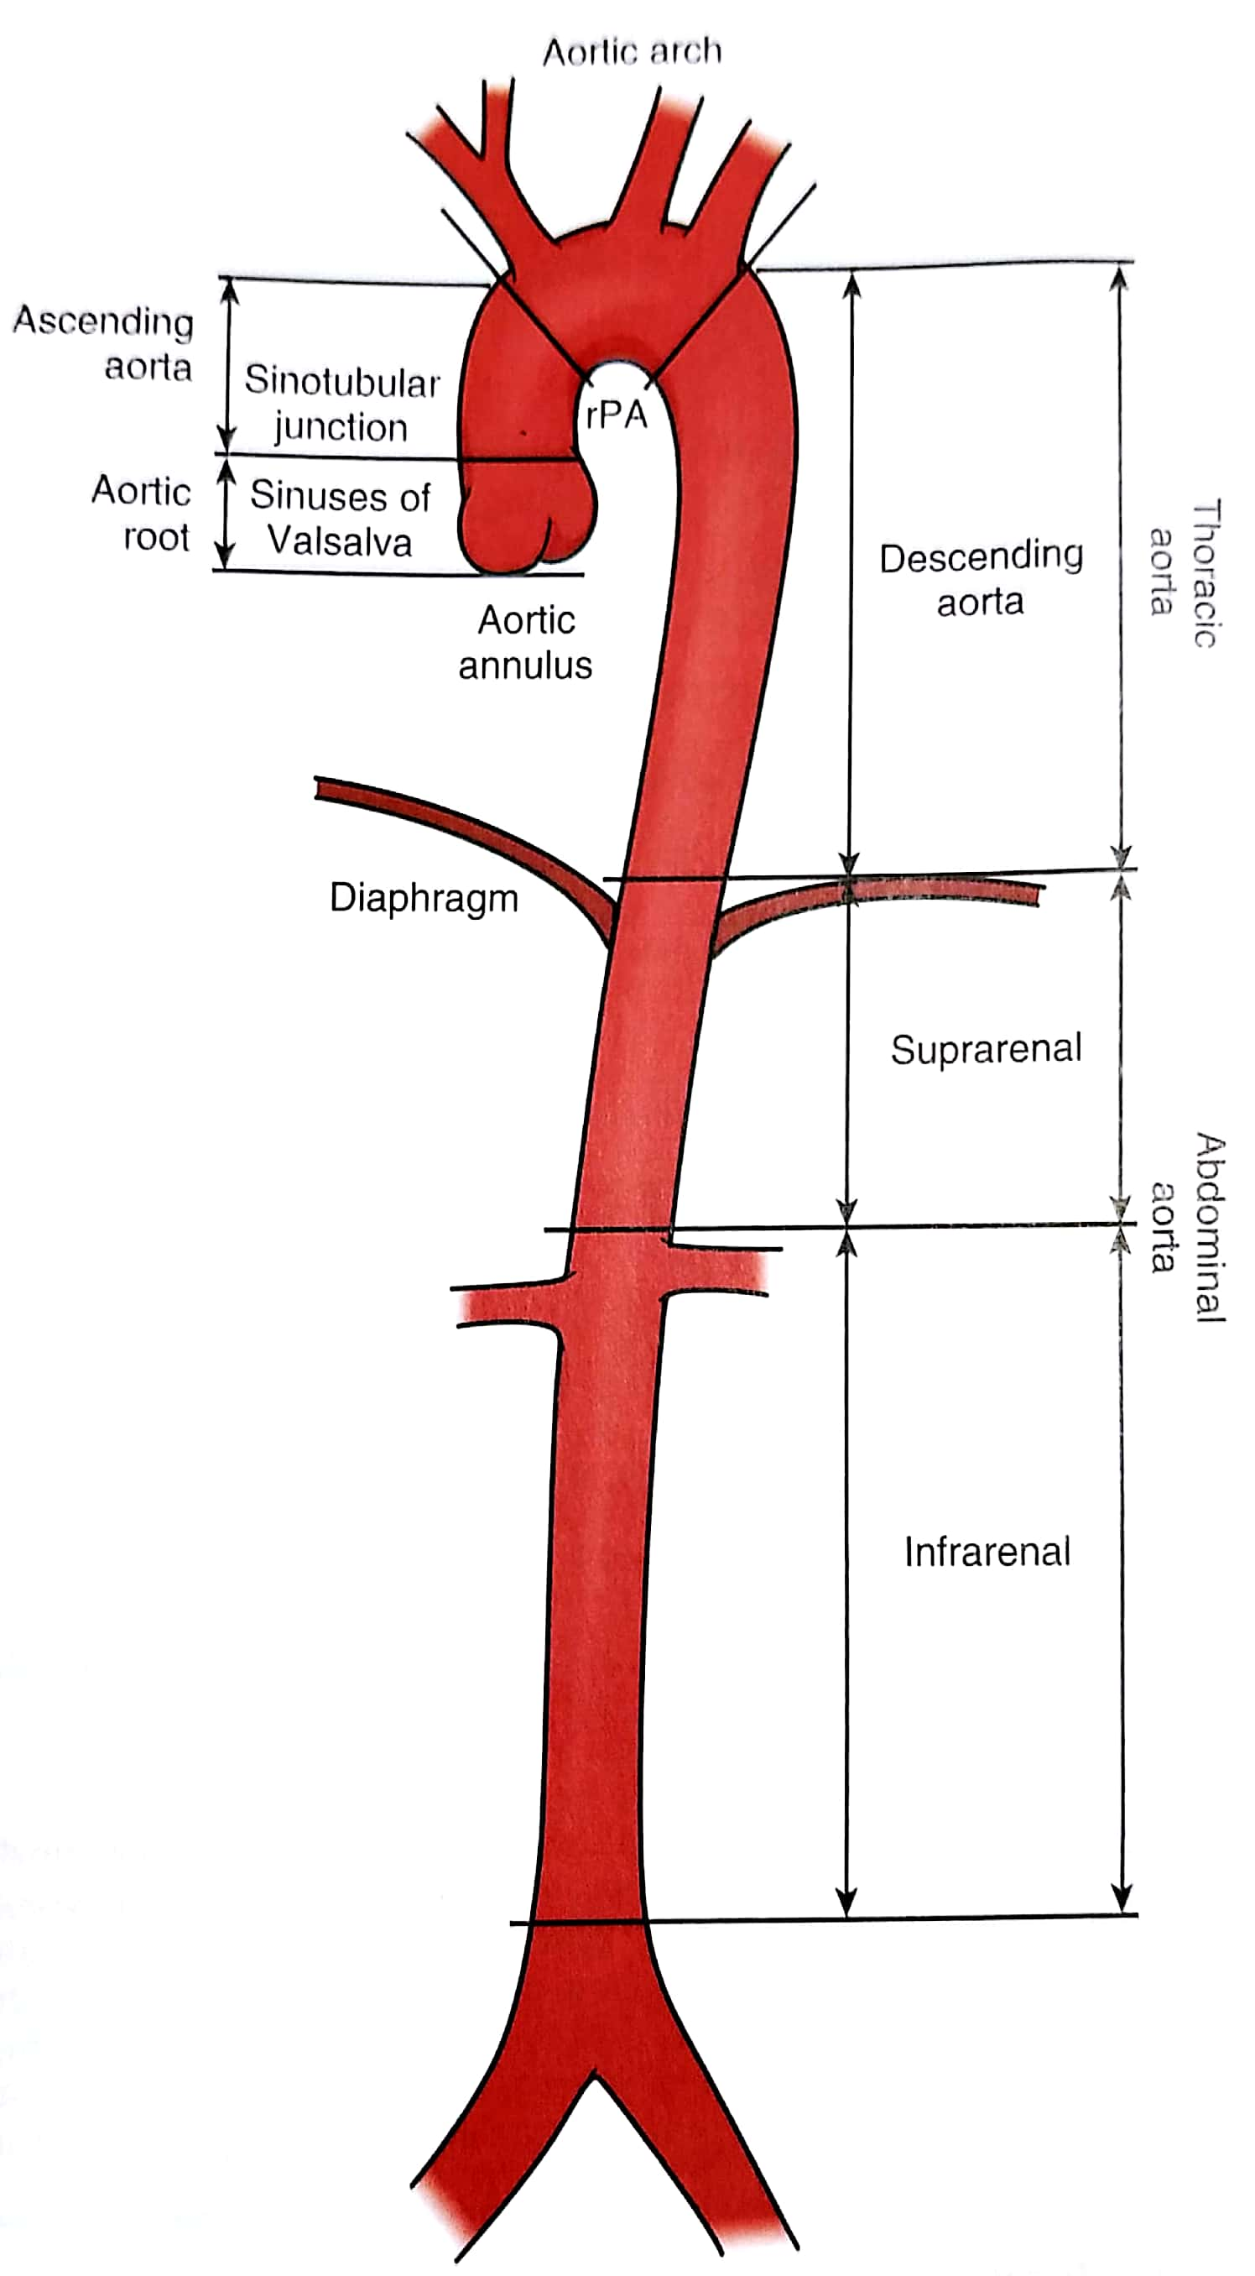
Anatomy & Physiology
Largest artery of body
Thoracic and Abdominal part
Aortic root
Ascending aorta
Aortic arch
Descending aorta
Supra-renal part
Infra-renal part
Notes:
Aortic root extends from the aortic valve to sinotubular junction. It supports the base of aortic leaflet and has coronary sinuses that gives rise to left and right coronary arteries.
Ascending aorta starts from sinotubular junction and extend till beginning of arch.proximal part of AA is embedded in pericardial cavity.
Arch gives rise to brachiocephalic A, left CCA and left SCA.
DA begins distal to left SCA and junction of arch and DA is called isthmus which is most vulnerable to deceleration trauma as mobile AA and arch vs fixed DA to thoraric cage. DA gives rise to paired post intercoastal art.
TA passes trough diaphragm and become Abd A.
Abd A bifurcates into CIA.

Slide 4
Elastic conduit.
Biochemical properties due to elastin and collagen in media and adventitia.
Nonlinear pressure-diameter relationship.
In healthy adults diameter not exceed 40 mm and taper gradually distally.
Rate of aortic expansion 0.9 mm in men and 0.7 mm in women per decade.
Factors affecting aortic diameter-age, sex, body size and BP.
Ageing decreases the curve steep
Increase in collagen to elastin ratio
Distortion of medial elastic fibres
Deposition of collagen and calcification
Atherosclerotic changes
Notes:
Elastic conduit and transmits pulsatile arterial BP to all points in arterial tree.
More distensible at low pressure and stiffer at high pressure transition @ 80 mmHg.
Ageing-more stiffer and more diameter.

Slide 5
Aortic Aneurysm
Second most frequent disease of aorta after atherosclerosis
Pathological segment of aortic dilatation that expands and can eventually rupture.
Greater than 50% of expected diameter.
Classification – Size, Shape, Location Morphology.
Notes:
AA defined as-pathological dilatation
One objective criteria for abnormal dilatation is 50% increase in dia wrt age, sex, body size.

Slide 6
Notes:
Fusiform more common-symmetrical dilatation with involvement of entire aortic circumference
Saccuilar focal outpouching
True-intact but dilated aortic wall
Pseudo aneurysms -bleeding occur through the aortic wall and results in contained periaortic hematoma in continuity with aortic lumen.

Slide 8
Crawford classification scheme based on the anatomic extent of the aneurysm
Notes:
Type I involves most of the descending thoracic aorta from the origin of the left subclavian to suprarenal abd aorta.
Type II is the most extensive, extending from the subclavian to the aortoiliac bifurcation.
Type III involves the distal thoracic aorta to the aortoiliac bifurcation.
Type IV TAAAs are limited to the abdominal aorta below the diaphragm.
Type V, which extends from the distal thoracic aorta including the celiac and superior mesenteric origins but not the renal arteries .

Slide 9
Abdominal aortic aneurysms
Defined by abdominal aorta greater than 3 cm in diameter
Most common form of aortic aneurysms.
Infra-renal 80%
10% para-renal or visceral.
Male 5x females.

Slide 10
Abdominal aortic aneurysms
Risk factors-
Age
Smoking
Emphysema
Hypertension
Hyperlipidemia
Family history
Genetics
Notes:
Age strong association with most cases seen with >60 yrs of age.
Smoking also strongly associated with 5x increase risk.
Family history seen in 20% of cases.
AA is associated with many genetic disorders like marfan syndrom, Loeys-Dietz syndrome, Ehlers-Danlos syndrome. Several genetic mutations are currently being found which have association with AA.

Slide 11
Pathogenesis
Chronic aortic wall inflammation.
Inflm causes infiltration of media with leukocytes, microphages, mast cells, lymphocytes etc.
Increased local expression of proteases.
Imbalance between degenerative and reparative processes and more degradation of structural connective tissue occurs.
Mechanical failure of medial elastin and adventitial collagen.
Aneurysmal dilatation and rupture.
Notes:
Inflammtion due to hemodynamic stress, ischemia, auto immune condition, atherosclerosis.
Inflm causes infiltration of media with leukocytes, microphages, mast cells, lymphocytes.
Proteases like MMP-9, cysteine protease, serine protease, elastases etc.

Slide 12
Pathogenesis

Slide 13
Clinical Features
Develops insidiously over many years.
Usually asymptomatic
Most are incidental finding on imaging studies.
Physical examination – pulsatile epigastric or periumbilical mass. Insensitive-only 30-40%
AAA associated with other aneurysms
85% of femoral artery aneurysm
60% of popliteal artery aneurysm
25% of thoracic aorta aneurysm
Notes:
Physical examination insensitive. if AA size is >5 cm and patient is thin built.

Slide 14
Risk of distal thromboembolism, rapid expansion or rupture.
Acute hemorrhage, severe abdominal pain, hypotension and sudden death
Periaortic hematoma with severe backache radiating to flank and groin.
Acute limb ischemia and claudication
Rupture has very high mortality
30-50% die before hospitalization
30-40% after hospitalization but before surgery
Post operative mortality is 40-50%
Mortality is less in EVAR as compared to OSR. (Eur J Vasc surg, 2016)
Notes:
Risk of TE, expansion, and rupture and patient presents with symptoms of these complications.

Slide 15
The annual risk of rupture based upon aneurysm size : (The Society for Vascular Surgery practice guidelines - Journal of Vascular Surgery, 2018)
Less than 4.0 cm in diameter = less than 1 in 200
4.0 to 4.9 cm in diameter = between 1 in 200 and 1 in 20
5.0 to 5.9 cm in diameter = between 1 in 20 and 1 in 10
6.0 to 6.9 cm in diameter = between 1 in 10 and 2 in 10
7.0 to 7.9 cm in diameter = between 2 in 10 and 4 in 10
8.0 cm or more in diameter = between 3 in 10 and 5 in 10
Notes:
Most importance of size of AA to predict risk of rupture.

Slide 16
Diagnostic imaging
Abdonimal USG
Non-invasive, inexpensive, free of radiation and contrast free
CT angiogram
More accurate than USG
Relationship of AAA with other vessels
Coexisting mural thrombosis, calcification, occlusive atherosclerosis
Enhance visualization of AAA before EVAR
MRA- Magnetic resonance angiography
Notes:
USG preferred for screening purposes. And for follow up of small size AAA.
CT angiogram is produced by use of radiographic contrast enhacement, very thin slice techniques and 3 dimensional reconstructional models.
MRA highly accurate, no radiation and contrast free, detailed study about aneurysm moprphology.

Slide 17
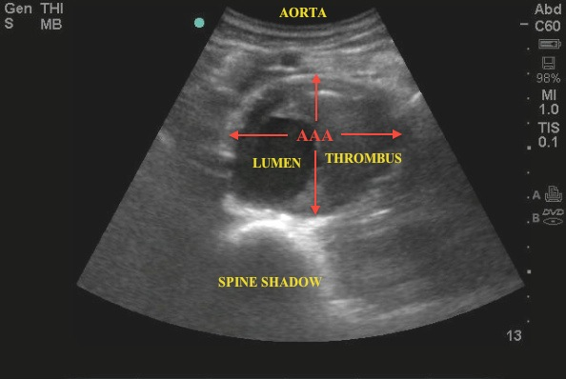
Diagnostic imaging

Slide 18
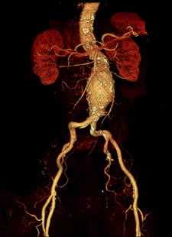

Slide 19
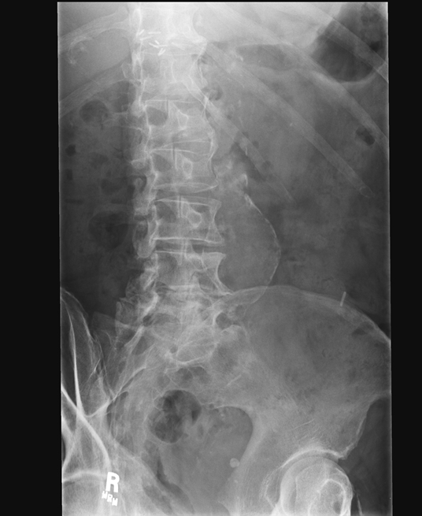
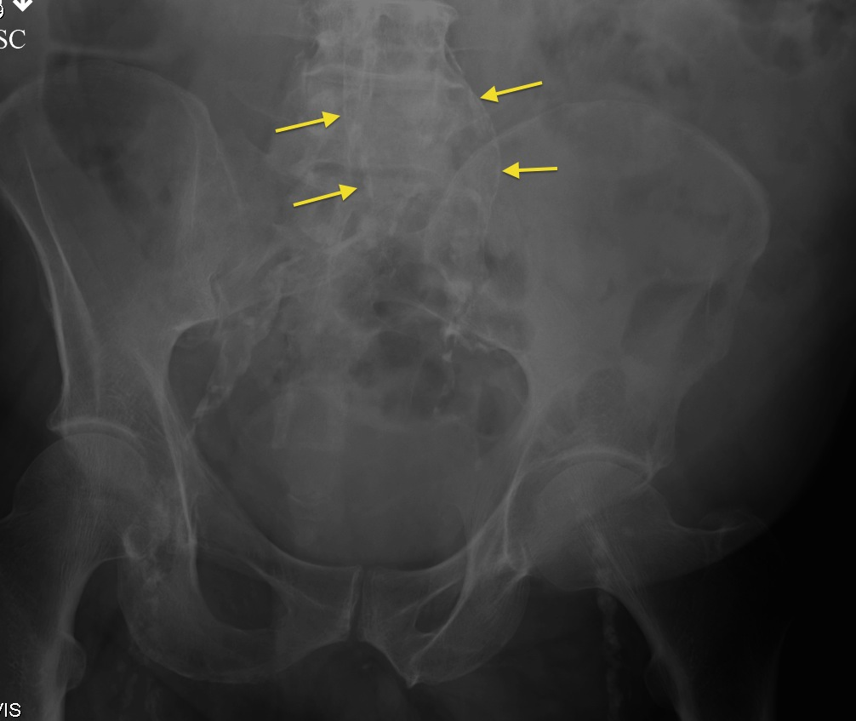
Notes:
X ray of abd showing abd aneurysm. X ray is insensitive and not used for diagnosis screening or management of AAA, but sometimes when AAA is ass with calcification, we can see AAA in an xray film.

Slide 20
Screening
Done using USG
Incidence
1 per 1000 in males over 60 years of age
7 per 1000 in males over 70 years of age
10% in males over 60 years of age with risk factors like smoking, F/H, HTN, atherosclerosis
Impact of screening-early diagnosis
50% reduction in rupture cases
50% reduction in overall aneurysm related mortality.
In females controversial with no clear survival benefit (MASS study)
Notes:
USG with colour doppler is recommended test for screening as it is inexpensive, easily available and free of radiation and contrast.
Age and smoking is two imp risk factor for AA and it is reflected in incidence rate.
Current recommdation for screening as given by SVS

Slide 21
The Society of Vascular Surgery recommendations for one time screening of AAA-
All males age >65 years
All males age >55 years with F/H of AAA
All females of age >65 years with F/H of AAA or H/o tobacco use

Slide 22
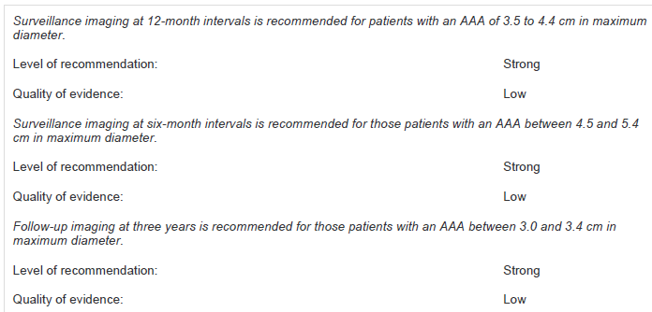
Surveillance
SVS surveillance imaging strategy
2.5-2.9 cm every 5 years
3.0-3.4 cm every 3 years
3.5-4.5 cm every 12 months
4.5-5.4 cm every 6 months
USG is used for small size aneurysms while for large size aneurysm >4.5 cm CT is preferred.
Notes:
A CT scan is recommended to evaluate patients that present with recent onset of abdominal or back pain,
particularly in the presence of a pulsatile epigastric mass or significant risk factors for AAA.

Slide 23
Medical management
Most medical therapy based for Risk reduction
smoking cessation
statin therapy
physical exercise
ACE inhibitors or Losartan (Hackam et al)
C. pneumoniae infection associated with an increased rate of AAA expansion and roxithromycin decreases the rate of aneurysm expansion. (Lindholt et al)
Doxycycline-MMP9 inhibitor
Experimental therapy-monoclonal antibodies against the proinflammatory protienases, elastase etc
Notes:
Smoking cessation has a strong step for reducing the AAA expansion rate.
Statin therapy in those whose have atherosclerosis
Mild to moderate Physical exercise is beneficial to reduce the growth rate in small to medium size aneurysm. Heavy workout is not advised due to risk of aneurysmal rupture
ACEI and losartan shown benefit in reducing the aneurysmal growth and there is increased incidence of rupture in patients who were previously on ACEI and then discontinue.
serological evidence of a C. pneumoniae infection is associated with an increased rate of AAA expansion and small randomized trial of approximately 100 patients demonstrated that a
one month course of roxithromycin decreased the rate of aneurysm expansion

Slide 24
Medical management
Many AAA associated with other Co-morbid diseases
CAD leading cause of early and late mortality after AAA repair.
CKD, COPD, Stroke and DM may influence morbidity and mortality.
A significantly lower incidence of myocardial infarction among patients undergoing EVAR as compared with open repair
EVAR should be considered inpatients with intermediate to high cardiac risk.

Slide 25
Preoperative cardiac evaluation for patients undergoing aneurysm repair
(ACC/AHA 2017 Guidelines on perioperative cardiovascular evaluation and care for noncardiac surgery: executive summary. Circulation 2017;116:1971-96.)

Slide 26
Preoperative cardiac evaluation for patients undergoing aneurysm repair
(ACC/AHA 2017 Guidelines on perioperative cardiovascular evaluation and care for noncardiac surgery: executive summary. Circulation 2017;116:1971-96.)
Notes:
Poor (1-3 METs) Eating, walking at 2-3 miles per hour, getting dressed, light housework (washing dishes)
Moderate (4-7 METs) Climbing a flight of stairs or walking up a hill, running a short distance, heavy housework
(scrubbing floors or moving furniture)
Good (7-10 METs) Doubles tennis, calisthenics without weights, golfing without cart
Excellent (>10 METs) Strenuous sports such as football, basketball, singles tennis, karate, jogging 10 minute mile or
greater, chopping wood

Slide 27
Preoperative cardiac evaluation for patients undergoing aneurysm repair
(ACC/AHA 2017 Guidelines on perioperative cardiovascular evaluation and care for noncardiac surgery: executive summary. Circulation 2017;116:1971-96.)
Notes:
Poor (1-3 METs) Eating, walking at 2-3 miles per hour, getting dressed, light housework (washing dishes)
Moderate (4-7 METs) Climbing a flight of stairs or walking up a hill, running a short distance, heavy housework
(scrubbing floors or moving furniture)
Good (7-10 METs) Doubles tennis, calisthenics without weights, golfing without cart
Excellent (>10 METs) Strenuous sports such as football, basketball, singles tennis, karate, jogging 10 minute mile or
greater, chopping wood

Slide 28
Surgery
Indications
Symptomatic AAA (tenderness or abdominal or back pain, evidence for embolization, rupture)
Asymptomatic aneurysm size ≥5.5 cm
AAA that has expanded by more than 0.5 cm within a six-month interval
Notes:
But here we should remember that size is not the only factor for risk assessment in AAA rupture. It is actually aortic wall stress. This aortic wall stress has size as a important factor according to law of Laplace.
But AAA geometry including, shape, expansion rate, and thrombus, as well as diastolic pressure and stiffness change also influence the wall stress.
A patient-specific “severity parameter'' to estimate the risk of AAA rupture has been proposed which includes all these parameters but it is complex and not validated yet.

Slide 29
Surgery
OSR via transperitoneal or left retroperitoneal approach
Occlusion by tube or bifurcated graft
Excluded aneurysm is not resected to prevent aorto-enteric fistula
OSR mortality 4 to 8%
OSR post op complications 10 to 30% (cardiac, pulmonary, renal, colonic ischemia)
OSR late complications 15 to 30% (incision related, perianstomosic aneurysm, graft infection, graft-enteric fistula and graft limd occlusions with LL ischemia
Notes:
Post op complications-cardiac, pulmonary, renal, colonic ischemia
Late comp-incision-hernia, bowel obstruction
Perianastomosis aneurysm-true and pseudo.

Slide 30
EVAR
Endovascular aneurysm repair (EVAR) is a relatively new method of treating aortic aneurysms
Performed by inserting graft components folded and compressed within a delivery sheath through the lumen of an access vessel, usually the common femoral artery
Upon deployment, the endograft expands, contacting the vessel wall proximally and distally to exclude the aortic aneurysm sac from aortic blood flow and pressure

Slide 31
EVAR-Preop planning and imaging
To define the anatomy
To determine the feasibility of endovascular repair
To choose the size and configuration of endograft components
CT angiography with 3-D reconstruction preferred because in 2D CT- aortic diameter measurements sometimes overestimated if the aorta is angulated and the longitudinal axis is not perpendicular to the imaging plane
MR angiography in setting of renal dysfunction. But MRA fails to depict vessel wall calcification, which has implications for vascular access

Slide 32
EVAR-Preop planning an imaging
Aortic neck diameter
Aortic diameter at the lowest renal artery
Endograft diameter required = 15 to 20% more of measured aortic neck diameter
Over-sizing - kinking of the device, incomplete expansion of graft, inadequate seal, a nidus for thrombus formation or endoleak
Under sizing- inadequate seal
Notes:
Aortic neck diameter-Aortic diameter at the lowest renal artery

Slide 33
EVAR-Preop planning an imaging
Aortic neck angulation
The angle formed between points connecting the lowest renal artery, the origin of the aneurysm, and the aortic bifurcation
Greater angle-difficulties in implantation, kinking, endoleak, and the potential for distal device migration
Ideally, the aortic neck angle should be < 60⁰

Slide 34
EVAR-Preop planning an imaging
Aortic neck length
The distance from the lowest renal artery to the origin of the aneurysm
Should be at least 10 to 15 mm to provide an adequate proximal landing zone for endograft fixation

Slide 35
EVAR-Preop planning an imaging
Iliac artery morphology
No significant stenosis ,mural thrombus, calcification and tortuosity
CIA is the preferred distal attachment site
When EIA is used for distal fixation the hypogastric artery needed to be embolized to prevent back bleeding into the aneurysm sac
EIA diameter of 7 mm is needed to allow safe passage of the endograft delivery sheath
Diffuse narrowing or significant calcification - an iliac conduit can be created

Slide 36
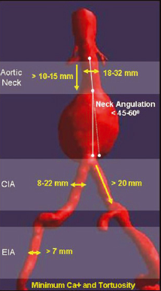
Ideal case for EVAR
Proximal neck length >10mm
Aortic neck angulation ≤60
Iliac artery diameter >7mm and < 15mm with Minimal to moderate tortuosity, No mural thrombus at attachment sites, Minimal calcification
No associated mesenteric occlusive disease

Slide 37
The main advantages over open repair
Avoidance of long incisions in the thorax or abdomen
No cross-clamping of the aorta
Less blood loss
Lower incidence of visceral, renal, and spinal cord ischemia
Less peri-operative mortality
Earlier return to normal activity
Recent trails have shown mortality benefit of EVAR over OSR

Slide 38
EVAR 1
Trial design: Patients with an AAA randomized to endovascular repair (n = 626) vs open repair (n = 626). Median follow-up was 6 years.
Results
(p = 0.72)
(p = 0.73)
30-day operative mortality: 1.8% with endovascular repair vs. 4.3% with open repair
All-cause death rate: 7.5/100 person-yrs vs. 7.7/100 person-yrs, respectively
Aneurysm-related death rate: 1.0/100 person-yrs vs. 1.2/100 person-yrs, respectively
7.5
7.7
per 100 person-years
Conclusions
Among patients with abdominal aortic aneurysm, endovascular repair associated with lower operative mortality with similar long-term all-cause mortality
Similar overall frequency of complications after endovascular repair
1.0
1.2
All-cause death
Aneurysm-related death
Endovascular repair
Open repair

Slide 39
EVAR 2
Trial design: Patients with an AAA ineligible for surgery were randomized to endovascular repair (n = 197) vs. medical management (n = 207). Median follow-up was 3.1 years.
Results
(p = 0.97)
(p = 0.02)
30-day operative mortality: 7.3% with endovascular repair
Rupture rate in the no repair group: 12.4/100 person-yrs
All-cause death rate: 21.0/100 person-yrs with endovascular repair vs. 22.1/100 person-yrs with no repair
21.0
22.1
per 100 person-years
7.3
Conclusions
3.6
In patients with abdominal aortic aneurysm, ineligible for open surgery repair, endovascular repair is associated with relatively similar overall mortality
Aneurysm-related death significantly reduced from endovascular repair
All-cause death rate
Aneurysm-related death rate
Endovascular repair
No repair

Slide 40
DREAM
Trial design: Patients with an AAA were randomized to endovascular repair (n = 173) vs. open repair (n = 178). Median follow-up was 6.4 years.
Results
Survival: 69% with endovascular repair vs. 70% open repair (p = 0.97)
Freedom from reintervention: 70% vs. 82% (p = 0.03), respectively
In the endovascular repair group, common causes for reintervention were thrombo-occlusive disease, endoleak, and graft migration
In the open repair group, a common cause for reintervention was treatment of incisional hernia
(p = 0.97)
(p = 0.03)
%
82
70
70
69
Conclusions
Among patients with abdominal aortic aneurysm, endovascular repair results in similar long-term survival as open repair; however, this approach results in the need for significantly more reinterventions
Survival
Freedom from reintervention
Endovascular repair
Open repair

Slide 41
OVER
Trial design: Patients with unruptured AAA were randomized to endovascular repair (EVAR) or open surgical repair. Patient follow-up was a mean of 1.8 years.
Results
30-day mortality ↑ with open repair (2.3% vs. 0.2%, p = 0.006); no difference at 2 years (9.8% vs. 7.0%, p = 0.13)
MI: 2.7% vs. 1.4%, p = 0.14; stroke: 0.9% vs. 1.6%, p = 0.38
Procedural time, duration of hospital stay ↓ in EVAR arm (p < 0.001)
(p = 0.13)
(p = 0.14)
20
20
%
10
9.8
%
10
7.0
Conclusions
2.7
long-term outcomes similar with EVAR and open repair for unruptured AAA; length of stay and procedural time was shorter for EVAR
1.4
0
0
Mortality at 2 years
MI at 1 year
Open repair
(n = 437)
EVAR
(n = 444)

Slide 43
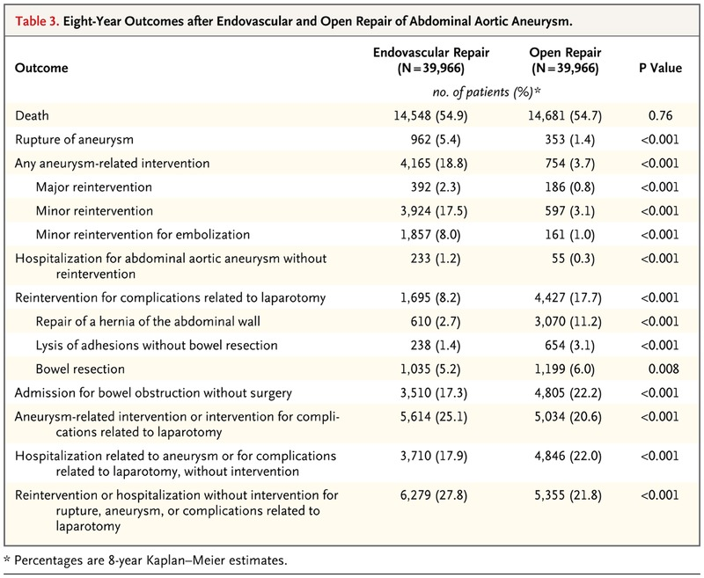

Slide 44
Review of Evidence EVAR vs OSR

Slide 45
Endografts
Fabric-covered stent
Significant variations in endovascular graft design
Three types of components are common to all:
A delivery system
Main body device
Extensions (limb)
Notes:
Typically delivered through the femoral artery, either percutaneously or by direct surgical cutdown
The size of the delivery system varies depending upon the device diameter
The main body device is usually bifurcated and rely mainly upon outward tension in the proximal graft to maintain its position.
Extensions are Iliac limbs on the main body device required for placement in iliac artery to complete the graft

Slide 46
AneuRx® device - Modular bifurcated stent graft composed of a nitinol exoskeleton and polyester lining. Distal and proximal extension cuffs are available.
The Gore Excluder -Modular bifurcated device, with a nitinol exoskeleton and a polytetrafluoroethylene graft. It has proximal barbs to anchor into the proximal infrarenal aorta.
The Powerlink®system- A unibody device made of polytetrafluoroethylene and a cobalt chromium alloy endoskeleton. It has a long main body and sits on the anatomic bifurcation
The Zenith® device-The bare proximal stents allow for suprarenal fixation. The device also has barbs to allow for more secure attachment into the suprarenal aorta. It is modular bifurcated with a stainless steel exoskeleton.
Notes:
Nitinol is a nickel-titanium alloy

Slide 47
Notes:
There are no clear advantages of one stent-graft design over another
The choice is based upon multiple factors, including patient anatomy, operator preference, and cost
Bifurcated grafts are most often chosen, but are not appropriate for patients with unilateral severe iliac stenosis or occlusion.
Unilateral iliac stenosis - unibody (nonbifurcated) grafts, also known as aorto-uni-iliac (AUI) devices, are used

Slide 48
Stepwise procedure
Gaining vascular access
Placement of arterial guidewires and sheaths
Imaging to confirm aortoiliac anatomy
Main body deployment
Gate cannulation (bifurcated graft)
Iliac limb deployment
Graft ballooning
Completion imaging

Slide 50
EVAR complications
Deployment related
Failed deployment
Bleeding
Hematoma
Lymphocoel
Infection
Embolization
Perforation
Arterial rupture
Dissection
Device related
Structural failure
Endoleaks
Limb occlusion/stent-graft kink
Sac enlargement/proximal neck dilatation
Stent migration
AAA rupture
Infection
Buttock/leg claudication

Slide 51
EVAR complications
Systemic
Cardiac
Pulmonary
Renal insufficiency, contrast-induced neuropathy
Deep vein trombosis
Pulmonary embolism
Coagulopathy
Bowel ischemia
Spinal cord ischemia

Slide 52
endoleak
Endoleak is a term that describes the presence of persistent flow of blood into the aneurysm sac after device placement
Five types of endoleaks are described

Slide 55
Type | Endovascular | Open surgery
Type I | Moulding balloon angioplasty Giant Palmaz stent Stent-graft cuff/ extension | External banding of aneurysm neck Surgical conversion
Type II | Trans-arterial embolisation Trans-lumbar injection | 30% decrease
Type III | Angioplasty/ stenting of junctions Secondary graft placement | Open conversion
Type V | Co-axial graft (‘re-lining’) | Evacuation of hygroma Open conversion

Slide 56
Thoracic aortic aneurysm
Estimated incidence 5 to 10 per 100,000
Aortic root and ascending aorta-60%
Descending aorta-35%
Thoracoabdominal aortic aneurysm-10%
Aortic arch <10%
Notes:
Thoraco abd which extend from decending aorta into abd aorta and divided into 5 types by crawford.

Slide 57
Risk factors-
Age
Smoking
Emphysema
Hypertension
Hyperlipidemia
Family history
Genetics
Genetic and heritable disorders are important cause of TAA especially of root and ascending aorta
Notes:
Risk factor similar to that of abd AA
Some of the important genetic and heritable disorders are-

Slide 58
Marfan syndrom
AD
FBN1 gene mutation
Abnormal fibrillin-1
Excess free TGF-β
Interaction with AT receptor and upregulation
Current reccomendation-maximal dose of beta-blocker or ARB treatment to reduce AA growth rate
Dutch Marfan Trial - losartan+beta blocker vs beta-blocker alone
Notes:
Fibrillin 1 interact with the latent TGF-B (transforming growth factor) and inhibits its activation
AT receptor activation causes disease progration.
Addition of losartan in marfan syndrom patient further reduces the AA growth.

Slide 60
Loeys-Dietz syndrom (LDS)
AD
Mutations in TGFBR1 and TGFBR2
4 types of LDS
More aggressive vascular phenotype than MFS
Aortic aneurysms and dissection more common than MFS and relatively younger age
Current recommendation-surgery if aortic root >4-4.5 cm

Slide 62
Vascular Ehlers-Danlos syndrom (vEDS)
AD
COL3A1 mutation
Abnormal type 3 procollagen synthesis
Medium sized vessels
Aortic root involvement less common. Mostly descending and abdominal aorta and its branches
Vessels are very fragile so high risk of sudden rupture and difficult surgical repair

Slide 63
Notes:
vEDS-TAA, AAA, MVP / joints hypermobility / translucent and lax skin / small joints / easy bruising

Slide 64
Turner syndrome
Complete or partial loss of second sex chromosome (XO, Xp)
50 to 75% CV defects
BAV 30%
Coarctation 12%
Ascending aorta dilatation 33%
Patient with TS+CV defect-100x increased risk of dissection
TS without CV defect every 5-10 years
TS with CV defect every 1-2 years
Notes:
TS screening of aorta

Slide 66
Bicuspid aortic valve disease
1% of general population
Ascending aortic aneurysm, coarctation of aorta, aortic disssection
BAV exhibits abnormal leaflet folding, wrinkling and doming causing turbulance even in absence of stenotic or regurgitant lesion
BAV compared to TAV aneurysm exhibit increased apoptosis, MMP-2 activity, TGF-β abnormalities, protien kinase-C pathway
Ascending TAA may develop independent of valve function
May develop later after AVR

Slide 67
Notes:
Relation between wall shear stress anf regional aortic tissue remodelling
Bicuspid valve in place of lamellar flow produces helical and aberrant flow which causes elevatedwall sheer stress.
This elevated sheer stress causes increase production of matrix proteases causing damage.

Slide 68
Syphilis and aortitis
Tertiary stage of syphilis
Latent period of 10 to 25 years
Rare due to antibiotic treatment
Mostly ascending aorta and arch
Tree bark or wrinkled appearance
Notes:
Lymphocytic and plasma cell infiltration of the intima gives classical tree bark app.

Slide 69
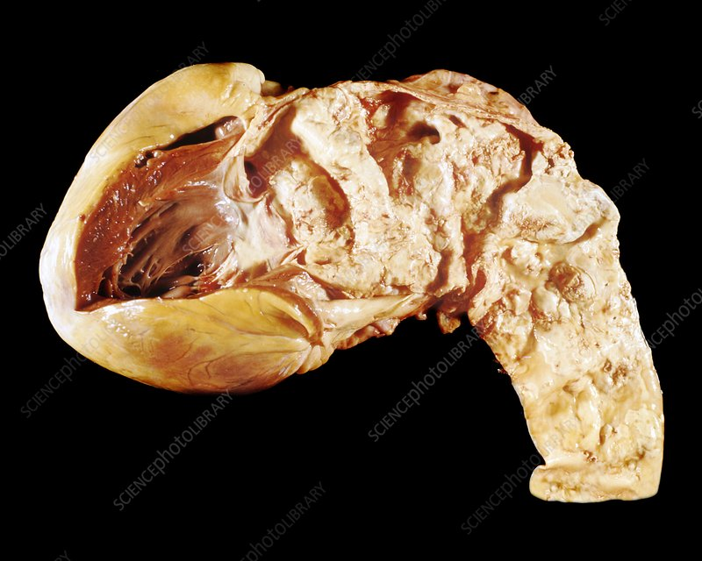
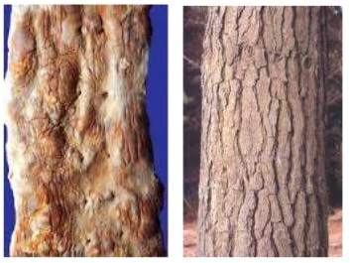
Notes:
Lymphocytic and plasma cell infiltration of the intima gives classical tree bark app.

Slide 70
Other infectious aortitis
Bacterial and fungal
Non infectious aortitis
Gaint cell arteritis, idiopathic aortitis, IgG4 disease, vasculitides
Aortic dissection
Mostly descending aorta, pseudo aneurysm
Degenerative aneurysm
atherosclerotic
Notes:
Degerative also involve mostly decending aorta and may extend to abdomen. These may form penetrating ulcer and rupture.

Slide 71
Clinical manifestation
Most are asymptomatic and discovered incidentally
Local mass effect, progressive AR, systemic emboliozation
Persistent chest or back pain
Compression of SVC, trachea or bronchus, esophagus
Rupture
Infection
Notes:
Compression can cause SVC syndrom, respiratory distress, hoarsness of voice, dysphagia
Patient my present with stroke, TIA, MI, acute limb ischemia due to systemic embolization of mural thrombus.
Rupture has very high mortality. If rupture more than 50% die before hospitalization and extra 25% die before any surgical procedure.
Rupture in mediastinum-hypotension and temponade, in pleural cavity, in esophagus-hemetemesis, in bronchus or trachea causing hemoptysis.
Infection causing pain fever and fistula formation

Slide 72
Diagnosis
Chest X-ray
Insensitive
TTE and TEE
CT angiogram
MRA
Notes:
Xray- small anuerysm not visible. Aneurysm of aortic root hidden under sternum, aortic tortuosity and unfolding in older people may mimic or mask TAA
CT angiogram is produced by use of radiographic contrast enhacement, very thin slice techniques and 3 dimensional reconstructional models. Excellent details about aneurysm.
MRA highly accurate, no radiation and contrast free, detailed study about aneurysm moprphology.
mask TAA.

Slide 74
Natural history
Factors affecting aneurysmal growth
Etiology-MFS, BAV
Location-descending aorta (2mm/yr) 2x of root and ascending aorta (1mm/year)
Size-larger the aneurysm size faster the growth
Ascending aorta size >6cm risk of aortic events-15.6%
Descending aorta aneurysm risk of aortic events
5.0 cm-5.5%
5.5 cm-7.2%
6.0 cm-9.3%
7.0 cm-15.4%
Notes:
Risk factor for rupture are similar to that of abdominal aortic aneurysm-Age/Smoking/Emphysema/Hypertension/Hyperlipidemia/Family history/Genetics

Slide 76
Surgery
Ascending aorta
Opening the ascending aorta and placement of a prosthetic graft with or without concomitant AVR
Modified Bentall procedure
David procedure
Yacoub procedure
Ross procedure

Slide 77
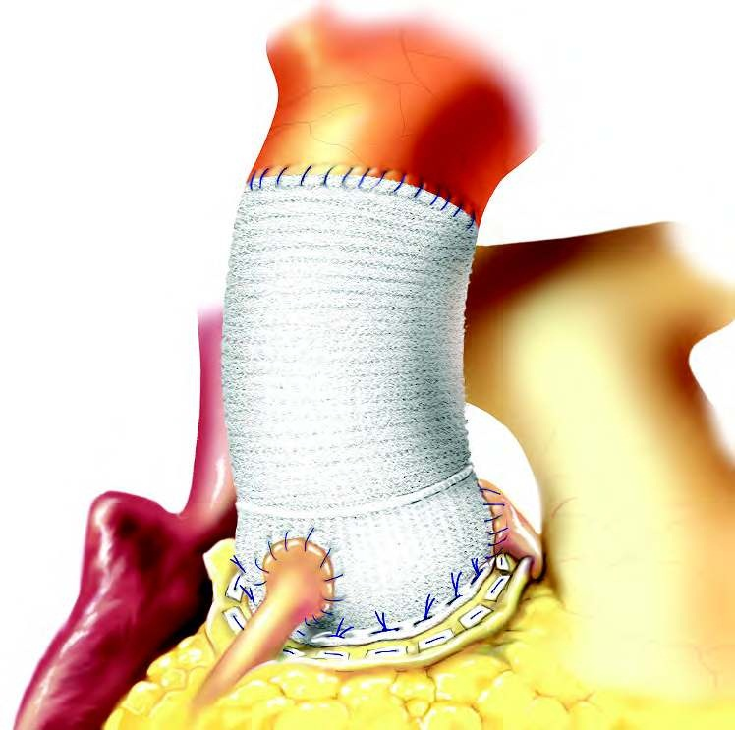
Notes:
Performed for aortic root aneurysm with damaged aortic valve
In bentall procedure a composite graft consisting of dacron tube with prosthetic AV is attached to the aortic annulus and coronary arteries are reimplanted into the dacron graft.

Slide 78
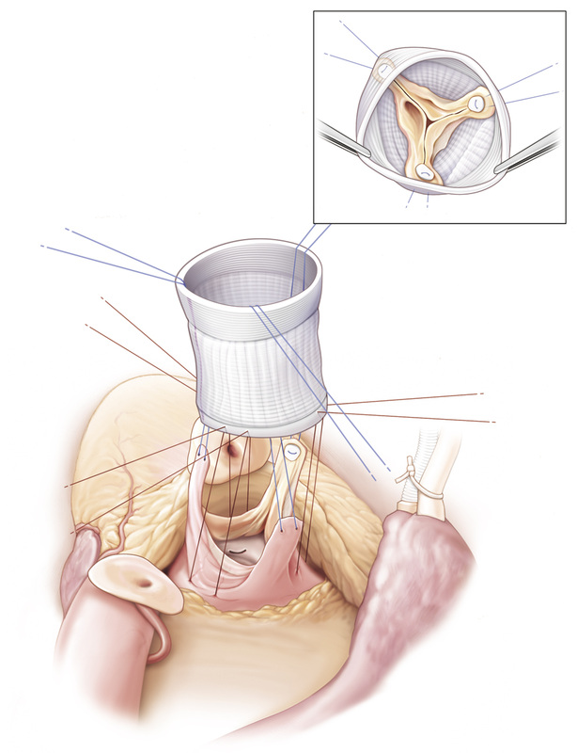
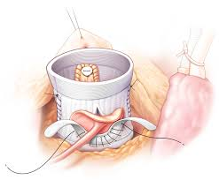
David procedure
Notes:
Davids procedure is done in Ascending AA with normal native valve. Here dacron tube is attached to the native AV without disturbing it.

Slide 79
Yacoub procedure
Notes:
Patients with ascending aortic aneurysm with structurally normal AV but having AR secondary to root dilatation. In Yacoub procedure supra coronary graft is placed along with sub valvular annuloplasty.

Slide 81
Surgery
Arch of aorta
Difficult surgically because of its branches.
Sx recommended when diameter >55 mm
Hemiarch resection
Extended arch resection
Elephant trunk procedure

Slide 82
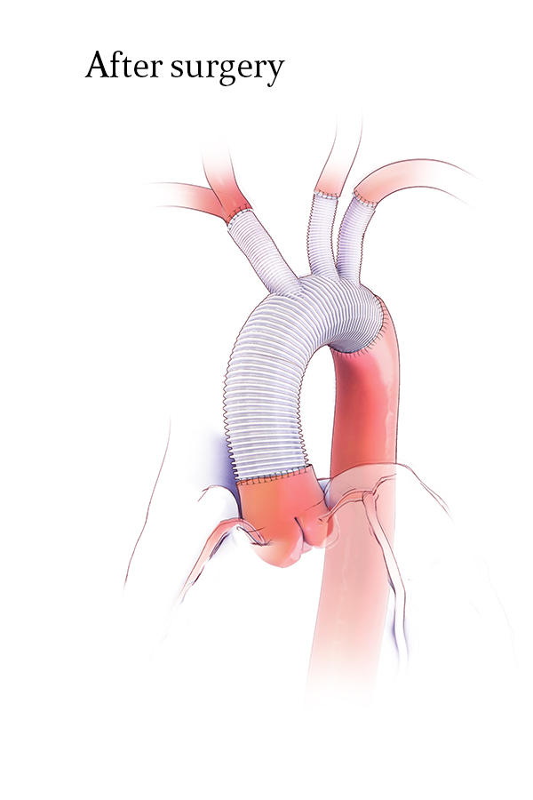
Hemi and Extended Arch Resection
Notes:
In hemiarch resection the branches of arch of aorta remains intact while in extended arch resection the entire arch is replaced and bypass is created of each great vessels

Slide 83
Elephant trunk procedure
Notes:
This is done when aortic aneurysm extends into descending aorta.
A polyester graft is extended into descending aorta as an elephant trunk and this graft is used to repair descending aorta aneurysm in second sitting.
A modification of this technique is frozen elephant trunk procedure in which a stent graft is put into the descending aorta after fixing its proximal site. Then stent is expanded using endovascular route. Both arch and descending aorta is corrected in single sitting.

Slide 84
Descending thoracic aneurysm-TEVAR
TEVAR refers to the percutaneous placement of a stent graft in the descending thoracic or thoracoabdominal aorta in patients with aortic aneurysms
The thoracic aorta is of larger caliber than that of the infrarenal aorta so needs larger diameter stent grafts
There is high force of blood flow in the thoracic aorta so requires a longer seal zone (20 mm both proximal and distal)
Hybrid approach- for proximal aneurysm

Slide 85
CHALLENGES OF ENDOVASCULAR REPAIR OF THE AORTIC ARCH
Seal Zone
Seal zone-a length of > 25 mm that is free of excess calcification and thrombus is required. Difficult to get due to curve part and various branching
Increase chances for type I endoleak and graft migration
Hybrid arch repair
Notes:
Principle technique of TEVAR is similar to EVAR

Slide 86
Device Durability
High pulsatoion of the aortic arch, subjecting the stents to more significant fatigue loading conditions
2 to 3 times higher than seen in the descending thoracic and abdominal aorta
Branch vessel motion relative to the aorta and respiration-graft wear, stent fracture, and stent kink
Research ongoing for new materials with long-term device durability

Slide 87
Aortic Valve
Current TEVAR systems large in diameter, and delivery system tips are relatively stiff
Increasing the risk of valve damage,
Endovascular devices and delivery systems that will limit valve interaction and be atraumatic to the valve when interactions do occur are required
Stroke
Stroke rates of > 6%
Emboli due to device, delivery system, and/or wire manipulation; air emboli released from the delivery system; and coverage of branched vessels.
Intentional coverage of the left subclavian artery with reanstomosis

Slide 88
CONCLUSION
TEVAR is a reliable way of preventing aortic-related death in patients with thoracic aortic aneurysms and results in less major morbidity than OSR.
Midterm follow-up suggests that midterm survival after repair of the thoracic aorta is poor, especially after TEVAR, which is mainly due to non–aortic-related death.
Information from large prospectively collected registries lacking

Slide 89
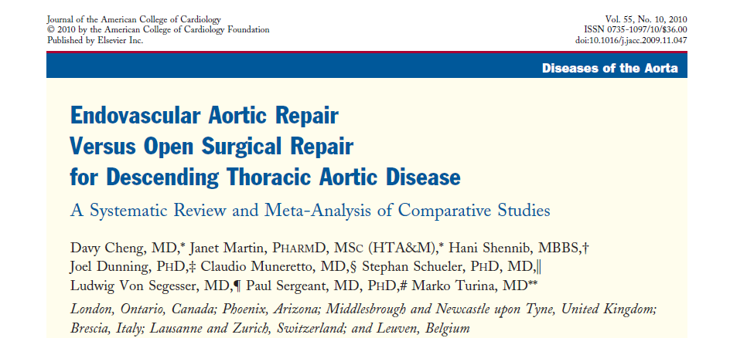
42 nonrandomized studies - 5,888 patients (38 comparative studies, 4 registries)
Conclusion: TEVAR may reduce early death, paraplegia, renal insufficiency, transfusions, reoperation for bleeding, cardiac complications, pneumonia, and length of stay compared with open surgery
Sustained benefits on survival have not been proven

Slide 90
THANK YOU.

